Slide 1
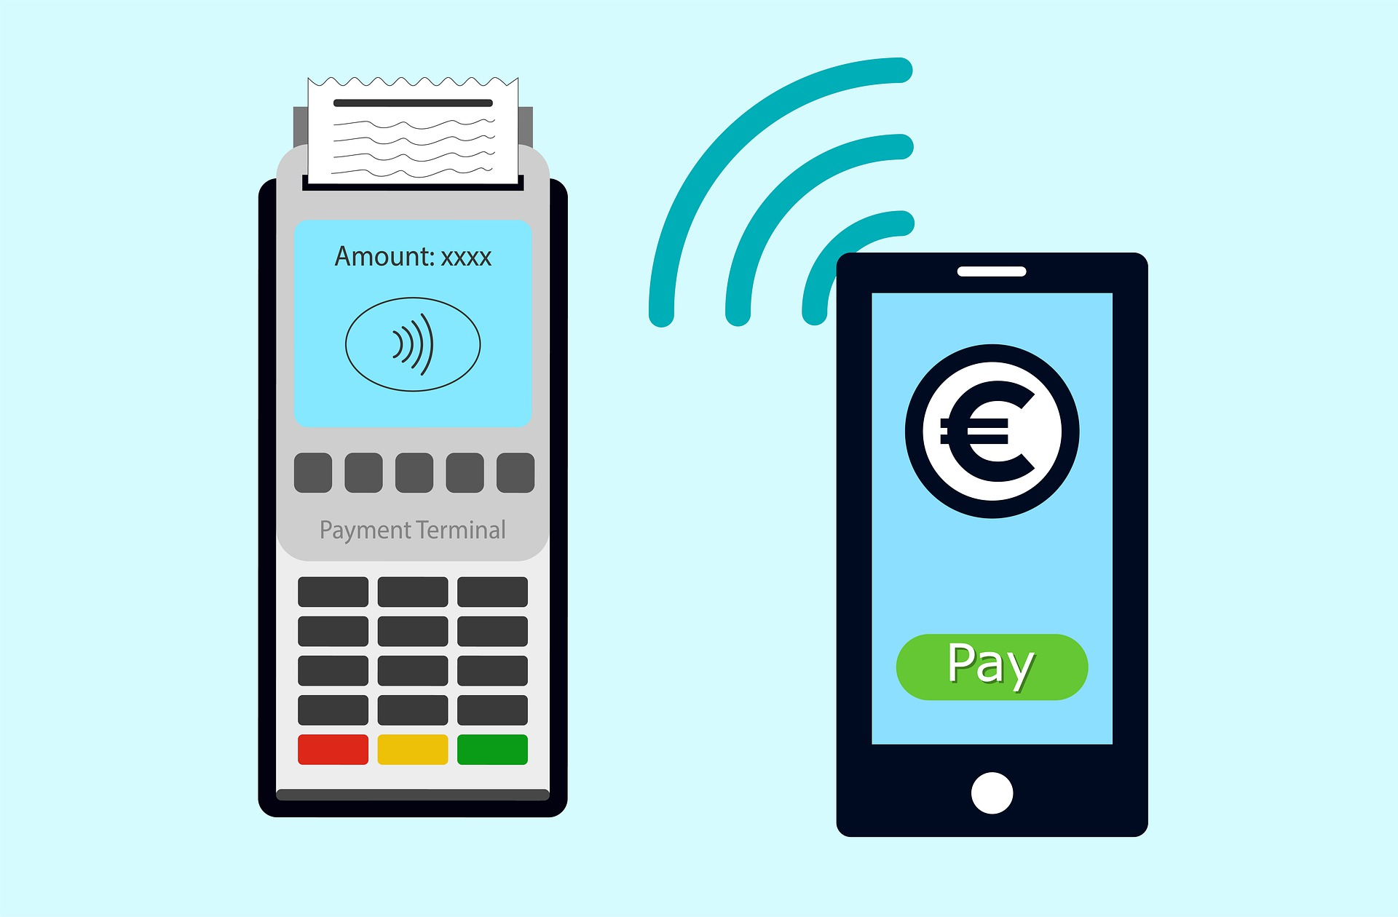
PAYMENT PROCESSING
Presented By
Shaik Chand Basha

Slide 2
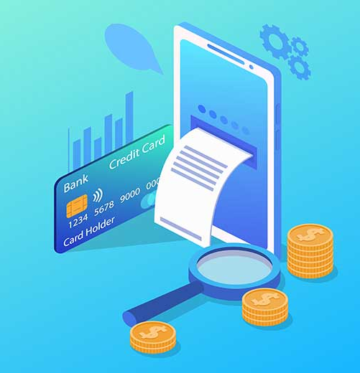
What we'll cover today
Overview of PAYMENT PROCESSING
Participants involved in the payment processing
How does it work?
Importance of Payment Processing
Benefits
Types of Payments are Processed by Payment Processing
Trends in Global Payments for 2022
Payment Processing Challenges
Example companies
Market value

Slide 3
Overview of PAYMENT PROCESSING
A credit card transaction might seem as simple as a swipe, dip, or tap, but it involves multiple steps and players
Payment processing is how businesses complete credit card and debit card transactions
Payment processing services expedite card transactions, and payment gateways securely transmit data so money from a customer’s issuing bank can be transferred to a merchant’s account
The end result is a customer who successfully makes a purchase without using cash or a check—and a business that completes a sale

Slide 4
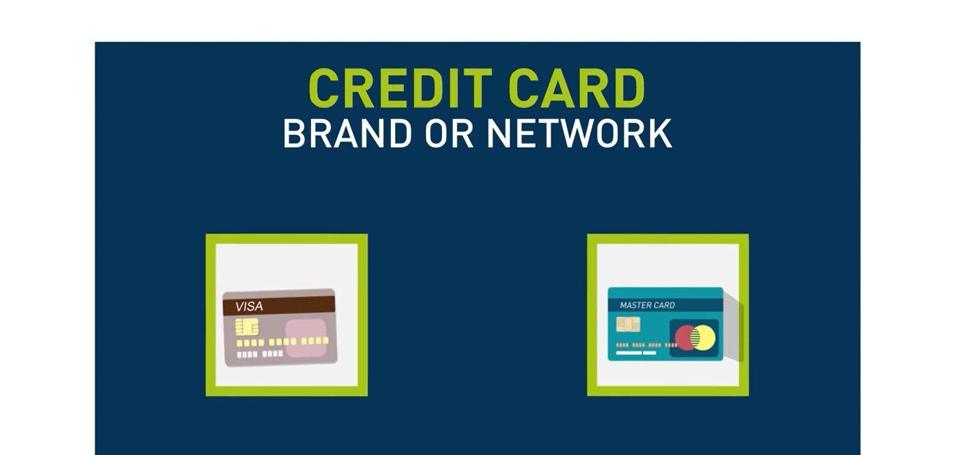
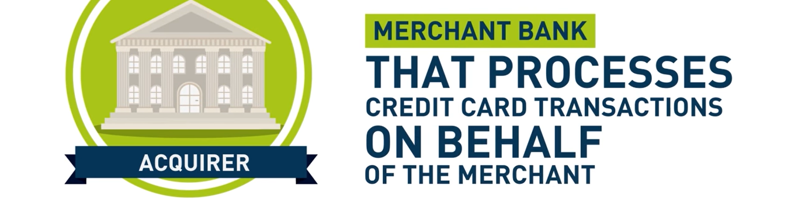
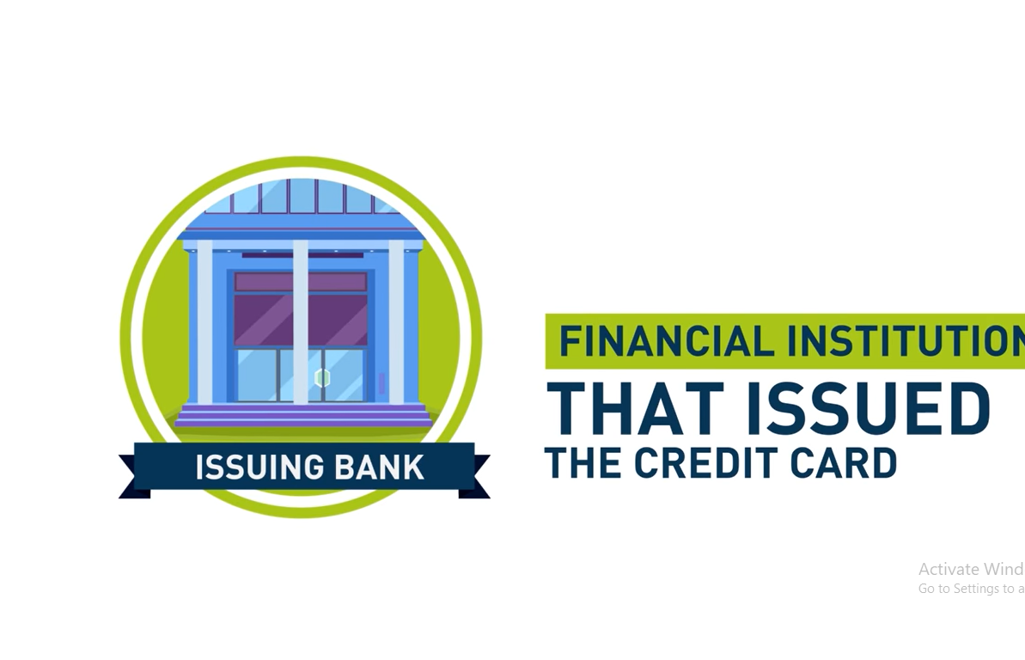
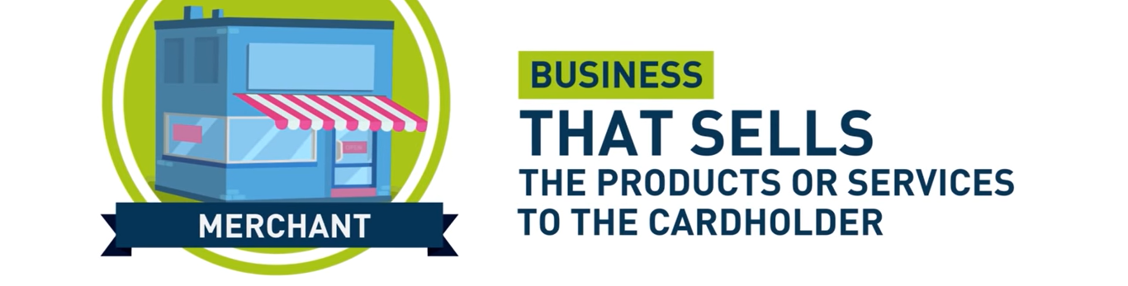
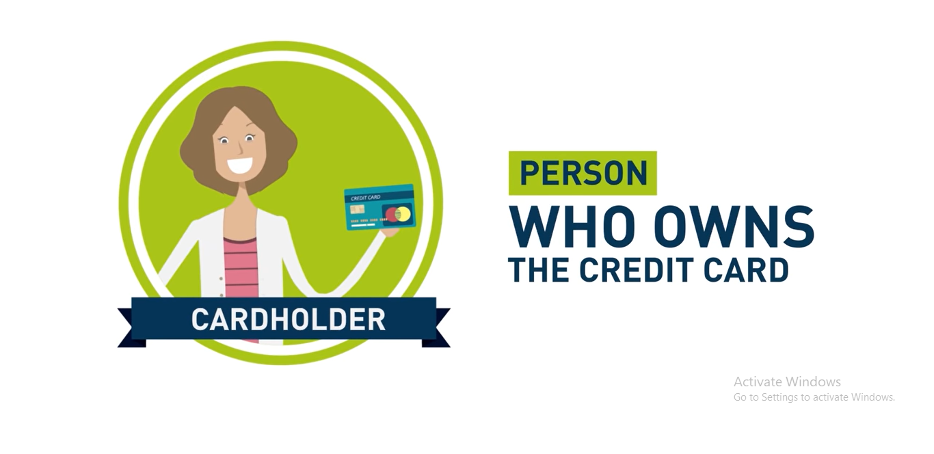
Participants involved in the payment processing

Slide 5
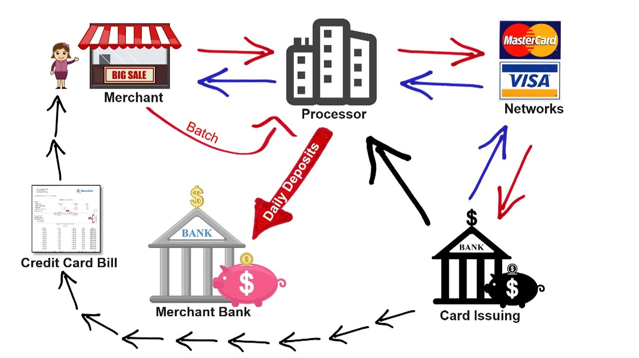
How does it work?
Credit card processing works in three distinct processes:
Authorization
Settlement
Funding

Slide 6
Importance of Payment Processing
In the past, merchants had to wait for batch reports from their transaction providers, and every detail had to be entered manually. There was a high risk of human error because of this reliance on manual inputs.
As a result of the payment processing integration, transaction data from various channels can flow smoothly into the business, keeping a tab on tasks that previously required human intervention.
It validates and authorizes payments by ensuring that the buyer has enough funds and that the card they are using is valid for transferring the funds into the seller's account

Slide 7
Benefits
1. Faster and Secure Transactions
The foremost advantage of having a payment gateway is the security and speed it offers to your payment processing environment. The best online payment gateways can help you receive payments nearly 50 times faster than you normally. This means you can provide a better shopping experience to your customers and regulate your cash flow without any hassle.
2. Minimum Set Up Costs
The initial set-up cost of most reputed payment gateways is affordable. It doesn’t matter if you’re running a small business or just getting started with a start-up, you can set up your payment gateway with minimum cost

Slide 8
Benefits
3. Save Your Time
The biggest reason why online payment gateways are loved by users is, they save a lot of time. It only takes a few seconds to make payments via an online payment gateway in India.
4. Keep Up With The Trends
Because payment gateways offer secure, faster and smoother transactions, they surely include almost all the possible payment options and this stays true even for the future. Payment gateway providers keep their systems up to date and this allows you to stay ahead in the payment processing landscape

Slide 9
Benefits
5. Reduce Declined Transactions
Declined transactions are another headache for businesses. They can cause a lot of inconveniences and incur additional costs, but not with a payment gateway
6. Payment Automation
Another perk of having an online payment gateway in India is that it reduces the need for human interference or labor work in your payment processing. Payment automation not only saves time and money but also minimizes errors. You can set up automatic withdrawals, recurring bills, and payouts using the right payment gateway.

Slide 10
Types of Payments are Processed by Payment Processing
Online payment processing allows you to accept many different payment methods. The most common ones include:
Debit/Credit Card: Debit and credit card payments are the most common and popular means used by customers.
Digital Wallets: In this method, customers register with an e-wallet company, such as Apple Pay or Google Pay, and link their bank account to their e-wallet account.
Bank Transfers: Although less popular than other payment methods, bank transfers give customers complete control over their transactions as they are the ones authorizing them.
E-Checks (ACH): Also known as electronic checks, this method of payment is not as widely used as others because it does not process instantly.

Slide 11
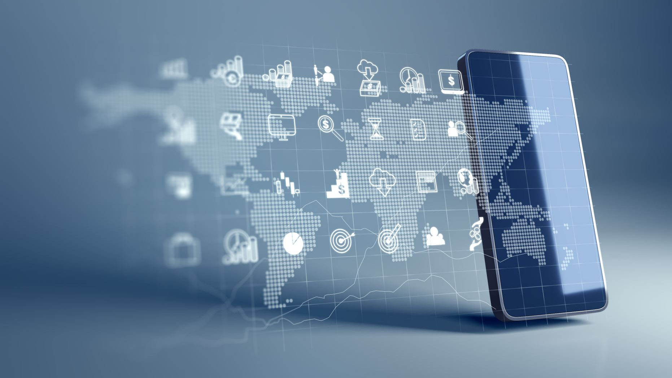
Trends in Global Payments for 2022
Buy Now, Pay Later (BNPL)
Mobile Wallets
Payment Orchestration
Cross-Border Transactions
Cybersecurity
Real-Time Payments

Slide 12

Payment Processing Challenges
1. Integration issues
2. Processing costs
3. Multi-channel payments
4. Security risks
5. Lack of support

Slide 13
Example companies of Payment Processing
PayPal
Stripe
Honey Book
Square
GoCardless

Slide 14

PayPal
PayPal is one of the famous payment processing company which suits all sized online businesses
PayPal is a convenient, easy to use, and ubiquitous payment platform
Key differentiators & advantages
Quick Checkouts
Enhance Security
Flexible Payment
Pricing is based per transaction. 2.5% + Fixed fee ( $0.041)
PayPal has a 'GOOD' User Satisfaction Rating of 4.68 when considering 20,047 Reviews
Founded: 2008 by Elon Musk and his team
key statistics
PayPal generated $25.3 billion revenue in 2021, an 18% increase year-on-year
PayPal reported $4.1 billion net income in 2021, slightly less than in 2020 but still 70% higher than 2019 values.
Over 19 billion transactions were completed in 2021 on PayPal, accounting for $1.2 trillion in transaction volume
426 million users and merchants use PayPal

Slide 15

Stripe
Next to PayPal, Stripe is also a leading payment processing company for online businesses
It is a bit tough to accommodate UI for non-technical customers
The main advantage in Stripe is that the clients are not redirected to another site while the payment process is going on and allows them to stay on the same page
Key differentiators & advantages
speedy and secure payment processing
Stripe doesn't have any monthly service fees and only charges business owners when a payment is processed
Pricing: Stripe charges 2.9% + $0.30 per transaction with no setup or monthly fees
Stripe has a 'GOOD' User Satisfaction Rating of 4.68 when considering 2,680 Reviews
Founded: 2009 by Patrick Collison and John Collison
key statistics
Currently 31 countries across the world such as The United States, Australia, etc., are supported by Stripe with 24 different currencies
Stripe's annual revenue went above $12 billion for the first time in 2021
Stripe has 2 million customers worldwide
3.1 million websites use Stripe for payment processing
For every $100 billion of transaction value, Stripe gets $2.9 billion
Stripe is now worth more than $95 billion

Slide 16
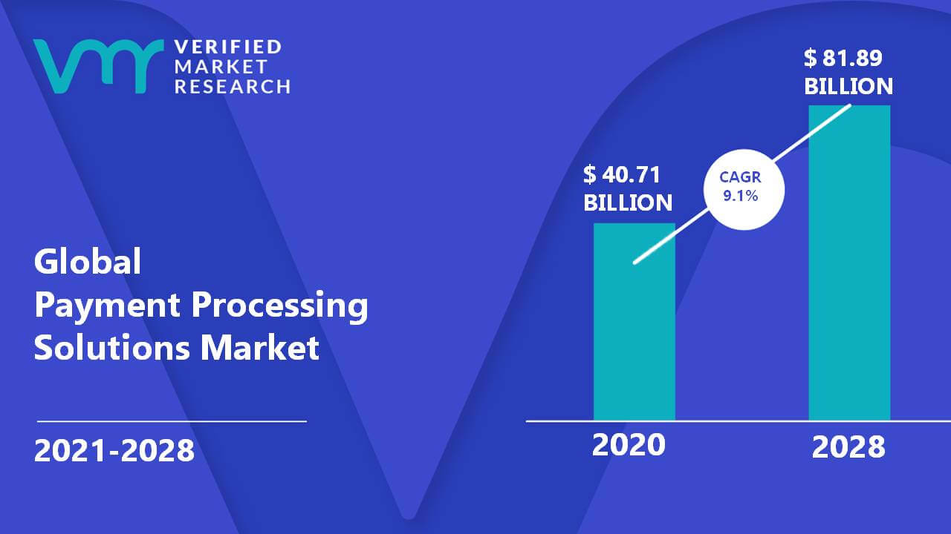
Market value
The global payment processing solutions market was valued at $ 90880 million in 2021
The global Payment Processing market size is projected to reach US$ 248930 million by 2028

Slide 17
THANK YOU

